Slide 1

Cohort 4 Q1. Hotels Project
Presented by: JEAN AMENYAGLO

Slide 2

Using data sourced from Cohort hotel database, analyze and draw insights to support executive decisions Highlight revenues and short falls , with recommendation on how to improve.
Overview:

Slide 3
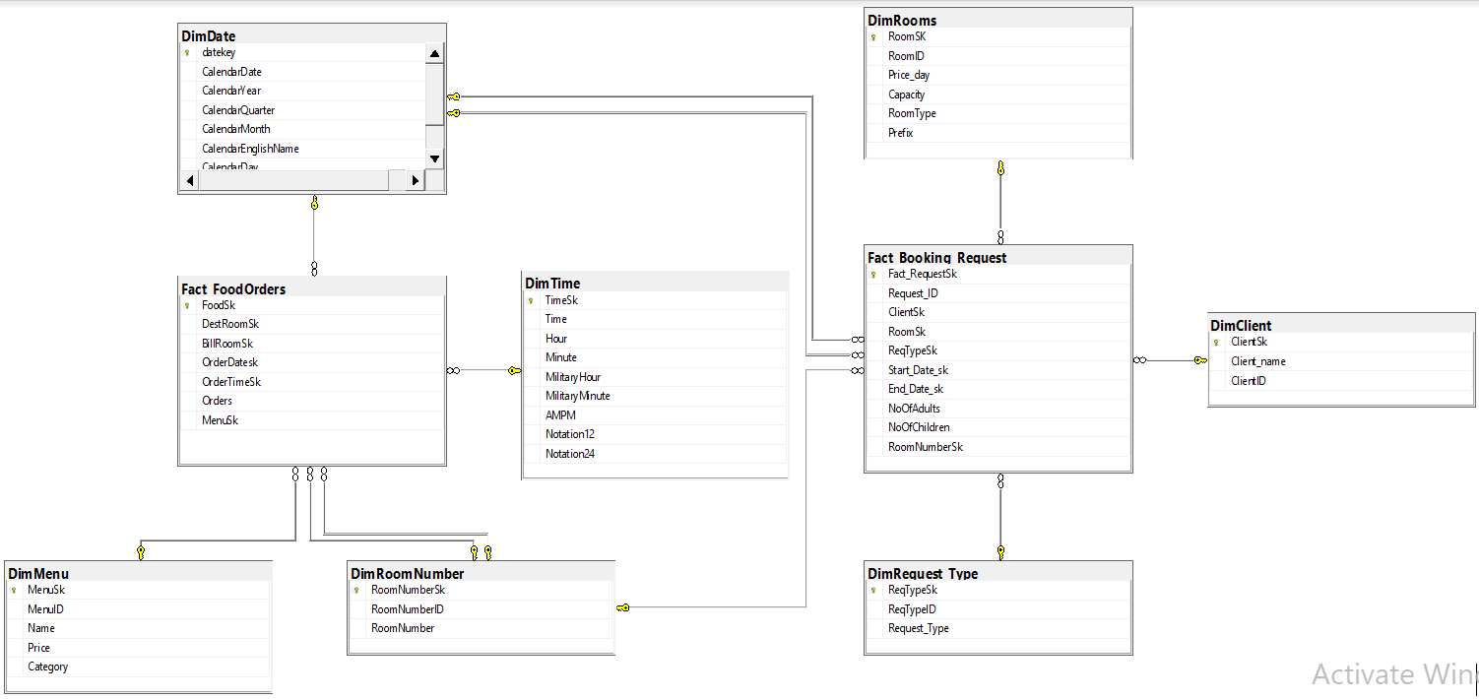
Entity Relationship Diagram

Slide 4
Entity Relationship Diagram Details:
In order to have a better perspective on our revenue generated for the hotel establishment, two facts tables were created, ie. “Fact_FoodOrders” and “Fact_Booking_Request”.
Fact_Booking_Request: This table is meant to handle transaction in relation to revenues from room accommodation, conferences etc.
Fact_FoodOrders: This on the other hand, deals with revenue generated from the restaurant in the hotel.

Slide 5
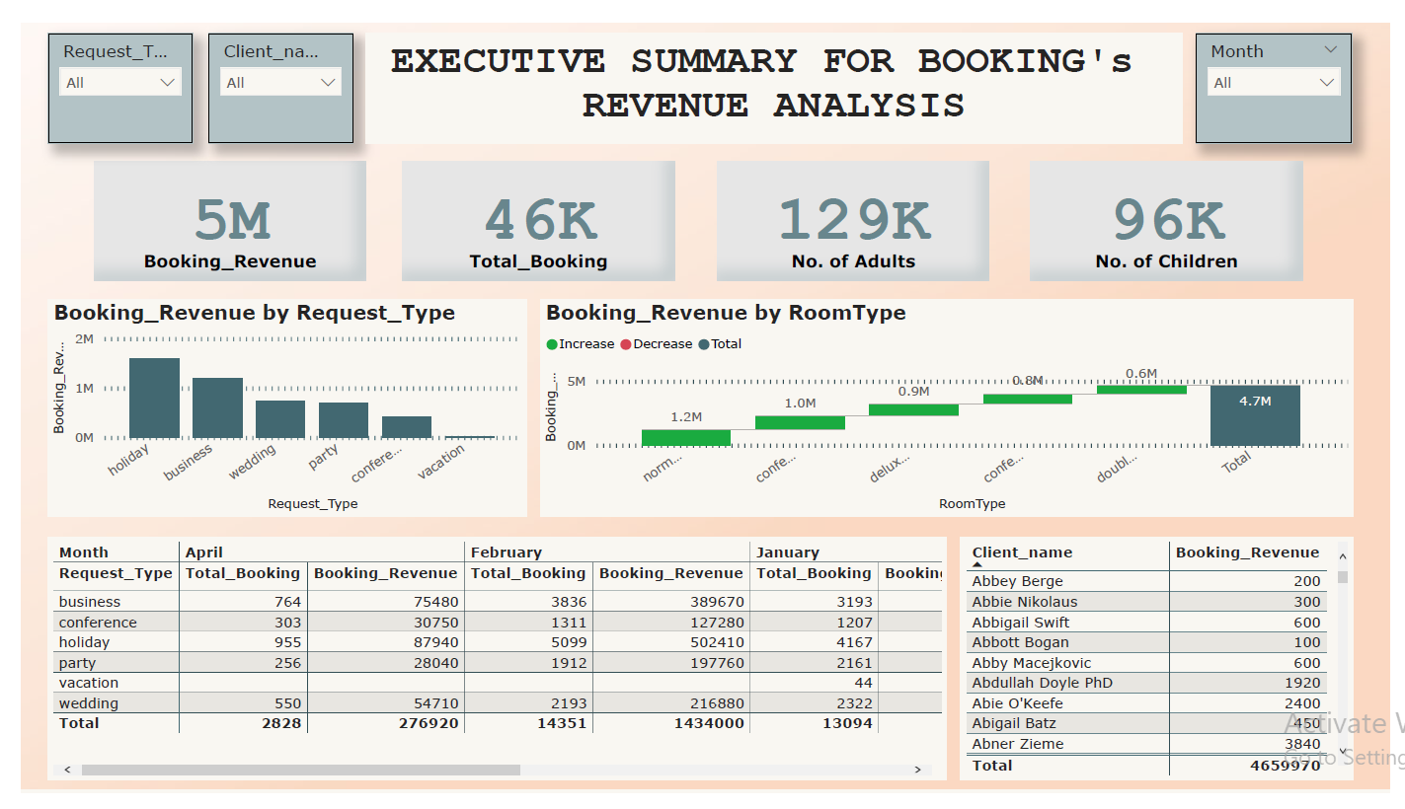

Slide 6
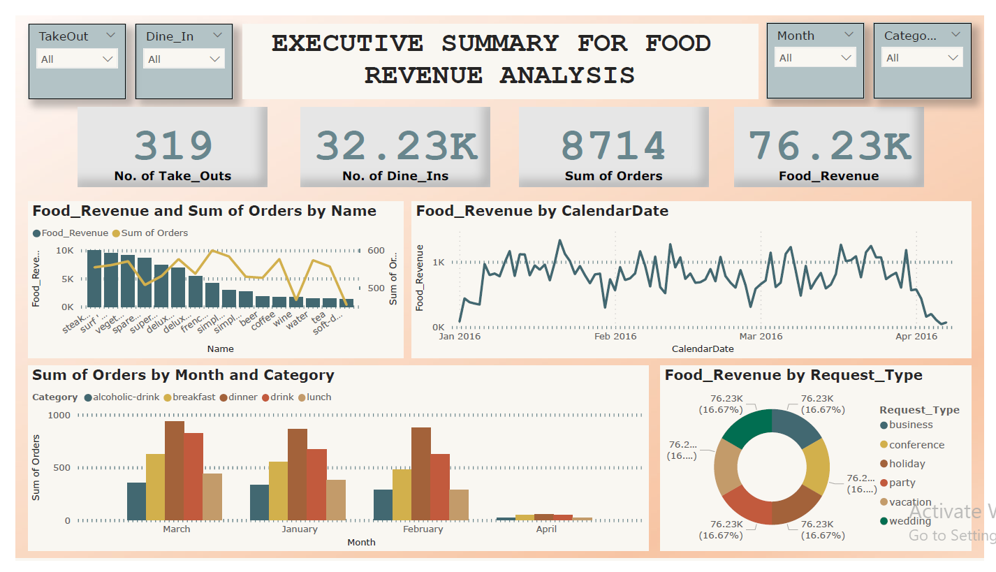

Slide 7
Observation
Inconsistent attribute naming convention, this makes it difficult to create the various joins and can be resolve with the use of aliases.
Some tables held duplicate data, which could simply be avoided using a simple join statement.
Inconsistencies in the data types and sizes, when moving the csv. files from Excel to the Azure Data Studio for data wrangling and cleaning.
Data integrity issues as some recorded date for 1916 and others for 2016.
Some tables hold excess data, clumsy data resulting in wasting of space and laborious extraction, transformation and load processes.
Redundant attributes

Slide 8
Recommendations
System Redesign:
Data capturing portals/applications of the system must be re-designed to enforce validation on required fields
A new database is also required to provide normalized data for analysis, ie. More information is needed on potential future clients, which present opportunities for future targeted digital marketing.
Automation:
The quality of data, propels high accuracy in our forecasting. Therefore, as we handle issues with data integrity. It is important to have a critical look into using business intelligence tools like Power BI and Tableau to structure future trend analysis and reports.
Data Capturing Policies:
It is important to consider standardized data capturing polies in our next system development, this will ensure smooth continuity beyond the systems original architecture.
Investment:
Investment is a robust data management application like Azure data studio is required. Also on the human resource aspect, there is a need to hire the services a qualified Data Analyst.

